Slide 1
Ping Pong
Uva 1428
(Beijing 2008, LA4329)
Time: 3 seconds

Slide 2
Problem Descriptions (1/3)
N (3 ≤ N ≤ 20000) ping pong players live along a west-east street(consider the street as a line segment).
Each player has a unique skill rank. To improve their skill rank, they often compete with each other. If two players want to compete, they must choose a referee among other ping pong players and hold the game in the referee’s house.

Slide 3
Problem Descriptions (2/3)
For some reason, the contestants can’t choose a referee whose skill rank is higher or lower than both of theirs.
The contestants have to walk to the referee’s house, and because they are lazy, they want to make their total walking distance no more than the distance between their houses.
Of course all players live in different houses and the position of their houses are all different.

Slide 4
Problem Descriptions (3/3)
If the referee or any of the two contestants is different, we call two games different.
Now is the problem: how many different games can be held in this ping pong street?

Slide 5
Input
The first line of the input contains an integer T (1 ≤ T ≤ 20), indicating the number of test cases, followed by T lines each of which describes a test case.
Every test case consists of N + 1 integers.
The first integer is N, the number of players.
Then N distinct integers a₁, a₂ . . . a_{N} follow, indicating the skill rank of each player, in the order of west to east (1 ≤ a_{i} ≤ 100000, i = 1 . . . N).

Slide 6
Output
For each test case, output a single line contains an integer, the total number of different games.

Slide 7
Sample Input / Output
Input
1
3 1 2 3
Output
1
Number of test cases
1
2
3
Skill rank of each player
Number of players

1
3
2

Slide 8
Problem Analysis
We have N players and a₁, a₂, a₃, a₄,… a_{N} are their skill rank, respectively.
If we consider i^{th} player as a referee, then we should calculate, c_{i}, the number of players whose skill rank is less than a_{i} from 1 to i-1.
If we consider i^{th} player as a referee, then we should calculate, d_{i}, the number of players whose skill rank is less than a_{i} from i+1 to N.
1 | 2 | 3 | 4 | … | i-1 | i | i+1 | i+2 | i+3 | … | N-1 | N
a₁ | a₂ | a₃ | a₄ | … | a_{i-1} | a_{i} | a_{i+1} | a_{i-1} | a_{i+3} | … | a_{N-1} | a_{N}
c_{i}
d_{i}

Slide 9

Problem Analysis
The number different games are
$$c_{i}×\left(n−i−d_{i}\right)+(i−1−c_{i})×d_{i}$$
左小
右大
左大
右小
1 | 2 | 3 | 4 | … | i-1 | i | i+1 | i+2 | i+3 | … | N-1 | N
a₁ | a₂ | a₃ | a₄ | … | a_{i-1} | a_{i} | a_{i+1} | a_{i-1} | a_{i+3} | … | a_{N-1} | a_{N}
c_{i}
d_{i}

Slide 10
Example
a_{i}
1 | 2 | 3 | 4 | 5
5 | 1 | 2 | 3 | 8
c₃=1
d₃=0

Slide 11
Example
a_{i}
1 | 2 | 3 | 4 | 5
5 | 1 | 2 | 3 | 8
scan
x_{i}
1 | 2 | 3 | 4 | 5 | 6 | 7 | 8
0 | 0 | 0 | 0 | 1 | 0 | 0 | 0
c_{i}
1 | 2 | 3 | 4 | 5
0 | 0 | 0 | 0 | 0

Slide 12
Example
a_{i}
1 | 2 | 3 | 4 | 5
5 | 1 | 2 | 3 | 8
scan
x_{i}
1 | 2 | 3 | 4 | 5 | 6 | 7 | 8
1 | 0 | 0 | 0 | 1 | 0 | 0 | 0
c_{i}
1 | 2 | 3 | 4 | 5
0 | 0 | 0 | 0 | 0

Slide 13
Example
a_{i}
1 | 2 | 3 | 4 | 5
5 | 1 | 2 | 3 | 8
scan
x_{i}
1 | 2 | 3 | 4 | 5 | 6 | 7 | 8
1 | 1 | 0 | 0 | 1 | 0 | 0 | 0
c_{i}
1 | 2 | 3 | 4 | 5
0 | 0 | 1 | 0 | 0

Slide 14
Example
a_{i}
1 | 2 | 3 | 4 | 5
5 | 1 | 2 | 3 | 8
scan
x_{i}
1 | 2 | 3 | 4 | 5 | 6 | 7 | 8
1 | 1 | 1 | 0 | 1 | 0 | 0 | 0
c_{i}
1 | 2 | 3 | 4 | 5
0 | 0 | 1 | 2 | 0

Slide 15
Example
a_{i}
1 | 2 | 3 | 4 | 5
5 | 1 | 2 | 3 | 8
scan
x_{i}
1 | 2 | 3 | 4 | 5 | 6 | 7 | 8
1 | 1 | 1 | 0 | 1 | 0 | 0 | 1
c_{i}
1 | 2 | 3 | 4 | 5
0 | 0 | 1 | 2 | 4

Slide 16
Example
a_{i}
1 | 2 | 3 | 4 | 5
5 | 1 | 2 | 3 | 8
scan
x_{i}
1 | 2 | 3 | 4 | 5 | 6 | 7 | 8
0 | 0 | 0 | 0 | 0 | 0 | 0 | 1
d_{i}
1 | 2 | 3 | 4 | 5
0 | 0 | 0 | 0 | 0

Slide 17
Example
a_{i}
1 | 2 | 3 | 4 | 5
5 | 1 | 2 | 3 | 8
scan
x_{i}
1 | 2 | 3 | 4 | 5 | 6 | 7 | 8
0 | 0 | 1 | 0 | 0 | 0 | 0 | 1
d_{i}
1 | 2 | 3 | 4 | 5
0 | 0 | 0 | 0 | 0

Slide 18
Example
a_{i}
1 | 2 | 3 | 4 | 5
5 | 1 | 2 | 3 | 8
scan
x_{i}
1 | 2 | 3 | 4 | 5 | 6 | 7 | 8
0 | 1 | 1 | 0 | 0 | 0 | 0 | 1
d_{i}
1 | 2 | 3 | 4 | 5
0 | 0 | 0 | 0 | 0

Slide 19
Example
a_{i}
1 | 2 | 3 | 4 | 5
5 | 1 | 2 | 3 | 8
scan
x_{i}
1 | 2 | 3 | 4 | 5 | 6 | 7 | 8
0 | 1 | 1 | 0 | 0 | 0 | 0 | 1
d_{i}
1 | 2 | 3 | 4 | 5
0 | 0 | 0 | 0 | 0

Slide 20
Example
a_{i}
1 | 2 | 3 | 4 | 5
5 | 1 | 2 | 3 | 8
scan
x_{i}
1 | 2 | 3 | 4 | 5 | 6 | 7 | 8
1 | 1 | 1 | 0 | 1 | 0 | 0 | 1
d_{i}
1 | 2 | 3 | 4 | 5
3 | 0 | 0 | 0 | 0

Slide 21

Example
a_{i}
1 | 2 | 3 | 4 | 5
5 | 1 | 2 | 3 | 8
c_{i}
1 | 2 | 3 | 4 | 5
0 | 0 | 1 | 2 | 4
d_{i}
1 | 2 | 3 | 4 | 5
3 | 0 | 0 | 0 | 0
$$0×\left(5−1−3\right)+0×3=0$$

Slide 22

Example
a_{i}
1 | 2 | 3 | 4 | 5
5 | 1 | 2 | 3 | 8
c_{i}
1 | 2 | 3 | 4 | 5
0 | 0 | 1 | 2 | 4
d_{i}
1 | 2 | 3 | 4 | 5
3 | 0 | 0 | 0 | 0
$$0×\left(5−2−0\right)+(2−1−0)×0=0$$

Slide 23

Example
2 3
1 2 8
a_{i}
1 | 2 | 3 | 4 | 5
5 | 1 | 2 | 3 | 8
c_{i}
2
1 | 2 | 3 | 4 | 5
0 | 0 | 1 | 2 | 4
d_{i}
1 | 2 | 3 | 4 | 5
3 | 0 | 0 | 0 | 0
$$1×\left(5−3−0\right)+(3−1−1)×0=2$$

Slide 24

Example
2 8
1 3 8
a_{i}
1 | 2 | 3 | 4 | 5
5 | 1 | 2 | 3 | 8
c_{i}
2+2=4
1 | 2 | 3 | 4 | 5
0 | 0 | 1 | 2 | 4
d_{i}
1 | 2 | 3 | 4 | 5
3 | 0 | 0 | 0 | 0
$$2×\left(5−4−0\right)+(4−1−2)×0=2$$

Slide 25

Example
a_{i}
1 | 2 | 3 | 4 | 5
5 | 1 | 2 | 2 | 8
c_{i}
1 | 2 | 3 | 4 | 5
0 | 0 | 1 | 2 | 4
d_{i}
1 | 2 | 3 | 4 | 5
3 | 0 | 0 | 0 | 0
$$4×\left(5−5−0\right)+(5−1−4)×0=0$$

Slide 26
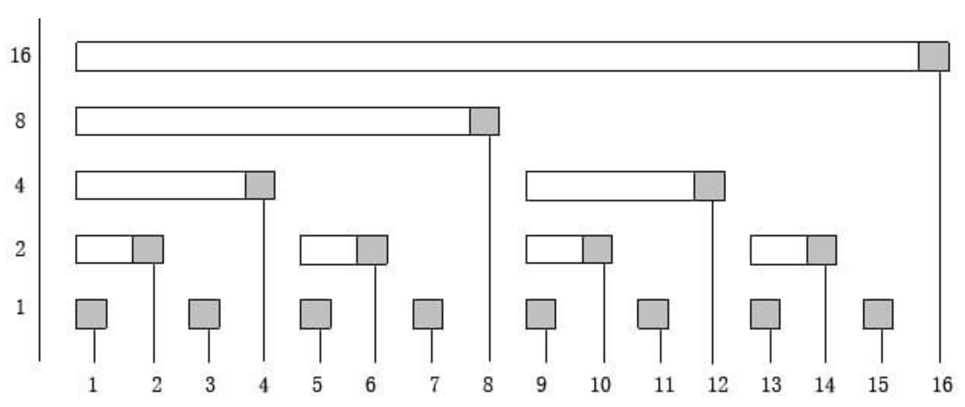
Fenwick Tree (Bit Index Tree, BIT)

Slide 27
Lowbit(k)
Lowbit(k) = k & -k
(2’s complement)
Example:
0100₂ ₍₄₎& 1100₂ ₍₋₄₎= 0100₂
0101₂ ₍₅₎& 1011₂ ₍₋₅₎= 0001₂

Slide 28
Fenwick Tree (Bit Index Tree, BIT)
Lowbit
Index i

Slide 29
Fenwick Tree (Bit Index Tree, BIT)
Lowbit
9-Lowbit(9)=8
Index i
2+Lowbit(2)=4
7-Lowbit(7)=6
14-Lowbit(14)=12
Parent of index i(right) i-Lowbit(i)
Parent of index i(left ) i+Lowbit(i)

Slide 30
BIT, add( ), sum( ), rsum( )
void add (int x, int d)
{ while (x<=n)
{ c[x]+=d; x+=lowbit(x);}
}
int sum(int x)
{ int ret=0;
while (x>0)
{ ret+=c[x]; x-=lowbit(x);}
}
int rsum(int x, int y)
{ return( sum(y)-sum(x-1) );
}

Slide 31
BIT, add(1, d)
k+=lowbit(k)
Index i
k=0001
k=0100
k=1000
k=10000
k=0010

Slide 32
BIT, add(2, d)
k+=lowbit(k)
Index i
k=0010
k=0100
k=1000
k=10000

Slide 33
BIT, add(3, d)
k+=lowbit(k)
Index i
k=0011
k=1000
k=10000
k=0100

Slide 34
BIT, add(4, d)
k+=lowbit(k)
Index i
k=0100
k=1000
k=10000

Slide 35
BIT, add(5, d)
k+=lowbit(k)
Index i
k=0101
k=1000
k=10000
k=0110

Slide 36
BIT, add(6, d)
k+=lowbit(k)
Index i
k=0110
k=1000
k=10000

Slide 37
BIT, add(7, d)
k+=lowbit(k)
Index i
k=0111
k=10000
k=1000

Slide 38
BIT, sum (7)
k-=lowbit(k)
0100
0110
Index i
0111

Slide 39
BIT, sum (12)
k-=lowbit(k)
1000
Index i
1100

Slide 40
BIT, rsum (7,12)
rsum(7,12) = sum(12)-sum(6)
Index i
rsum(7,12) = sum(12)-sum(6)

Slide 41
Time Complexity
Brute Force: O(n)
add : O(log n)
sum : O(log n)

